Slide 1
Promptable Pathology
Visual Foundation Models for Medical Image Segmentation
CSCE 689 • Fall 2025 • Texas A&M University

Slide 2
Problem: Manual Annotation is Expensive
• Pathologists spend 15-30 min per slide
• Expert annotation costs $50-100 per image
• High inter-observer variability
• Limited labeled data for rare conditions
•
• Solution: Visual Foundation Models
• Pre-trained on billions of images
• Zero-shot capability → no training needed
• Promptable interface → flexible interaction

Slide 3
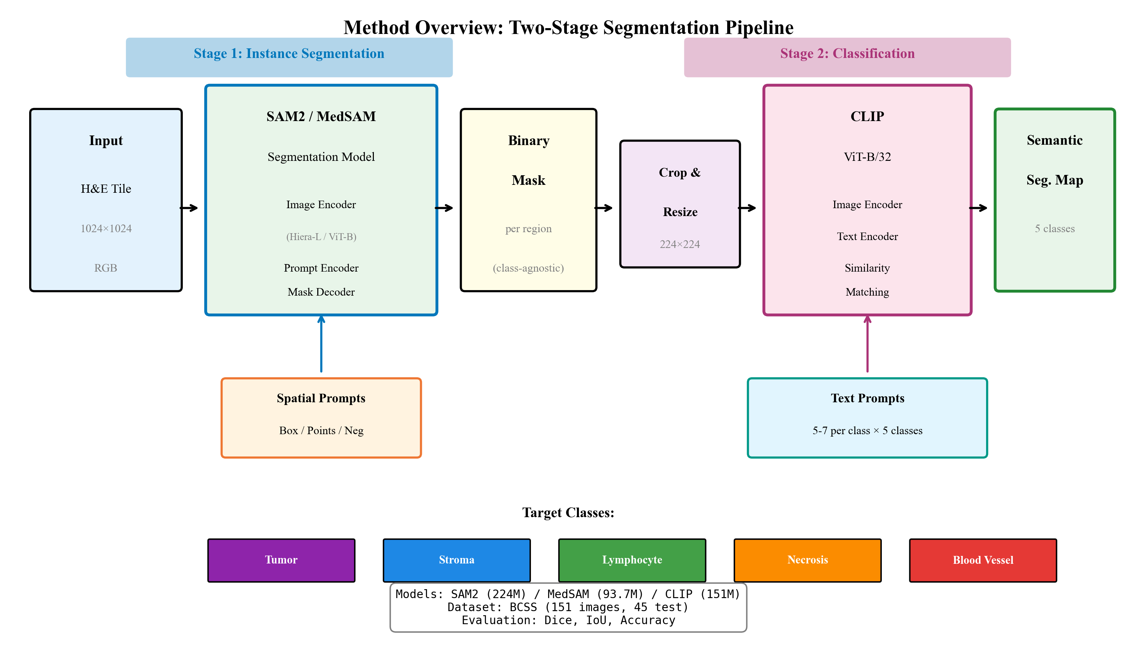
Two-Stage Pipeline: SAM2 → CLIP
Stage 1: SAM2 segments tissue regions | Stage 2: CLIP classifies each region

Slide 4
Dataset: BCSS (Breast Cancer Semantic Segmentation)
• Source: TCGA (The Cancer Genome Atlas)
• 151 H&E stained images @ 0.25 μm/pixel
• 5 tissue classes: Tumor, Stroma, Lymphocyte, Necrosis, Blood Vessel
• Splits: 85 train / 21 val / 45 test
• Challenge: Class imbalance (lymphocytes rare, stroma dominant)

Slide 5
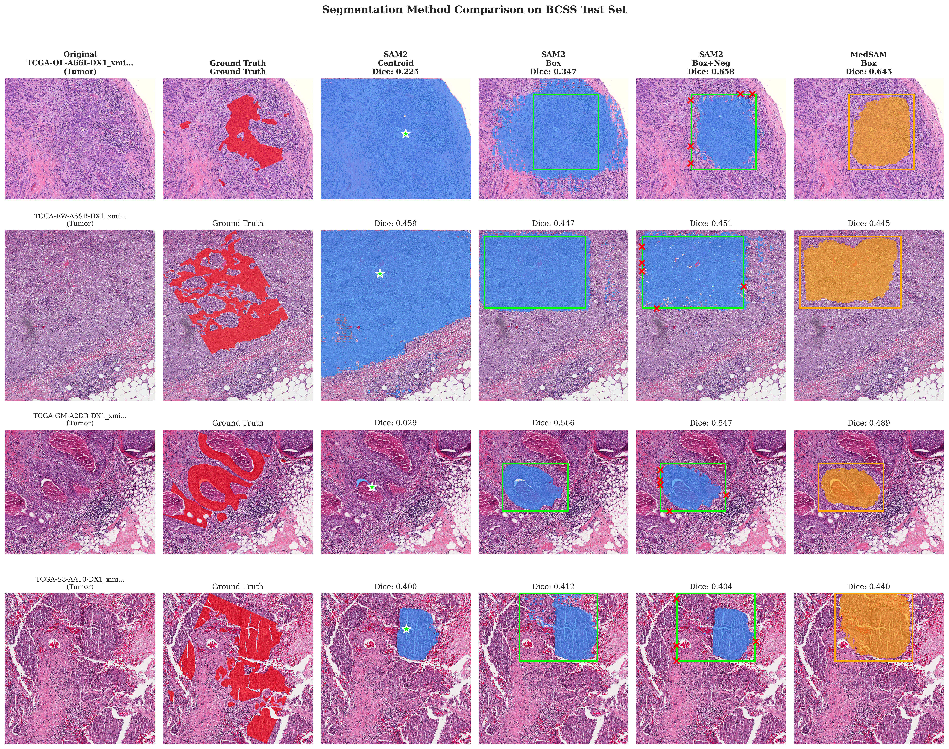
Segmentation Results: SAM2 vs MedSAM
4 test images × 6 methods: Original → GT → SAM2 Centroid/Box/Box+Neg → MedSAM

Slide 6
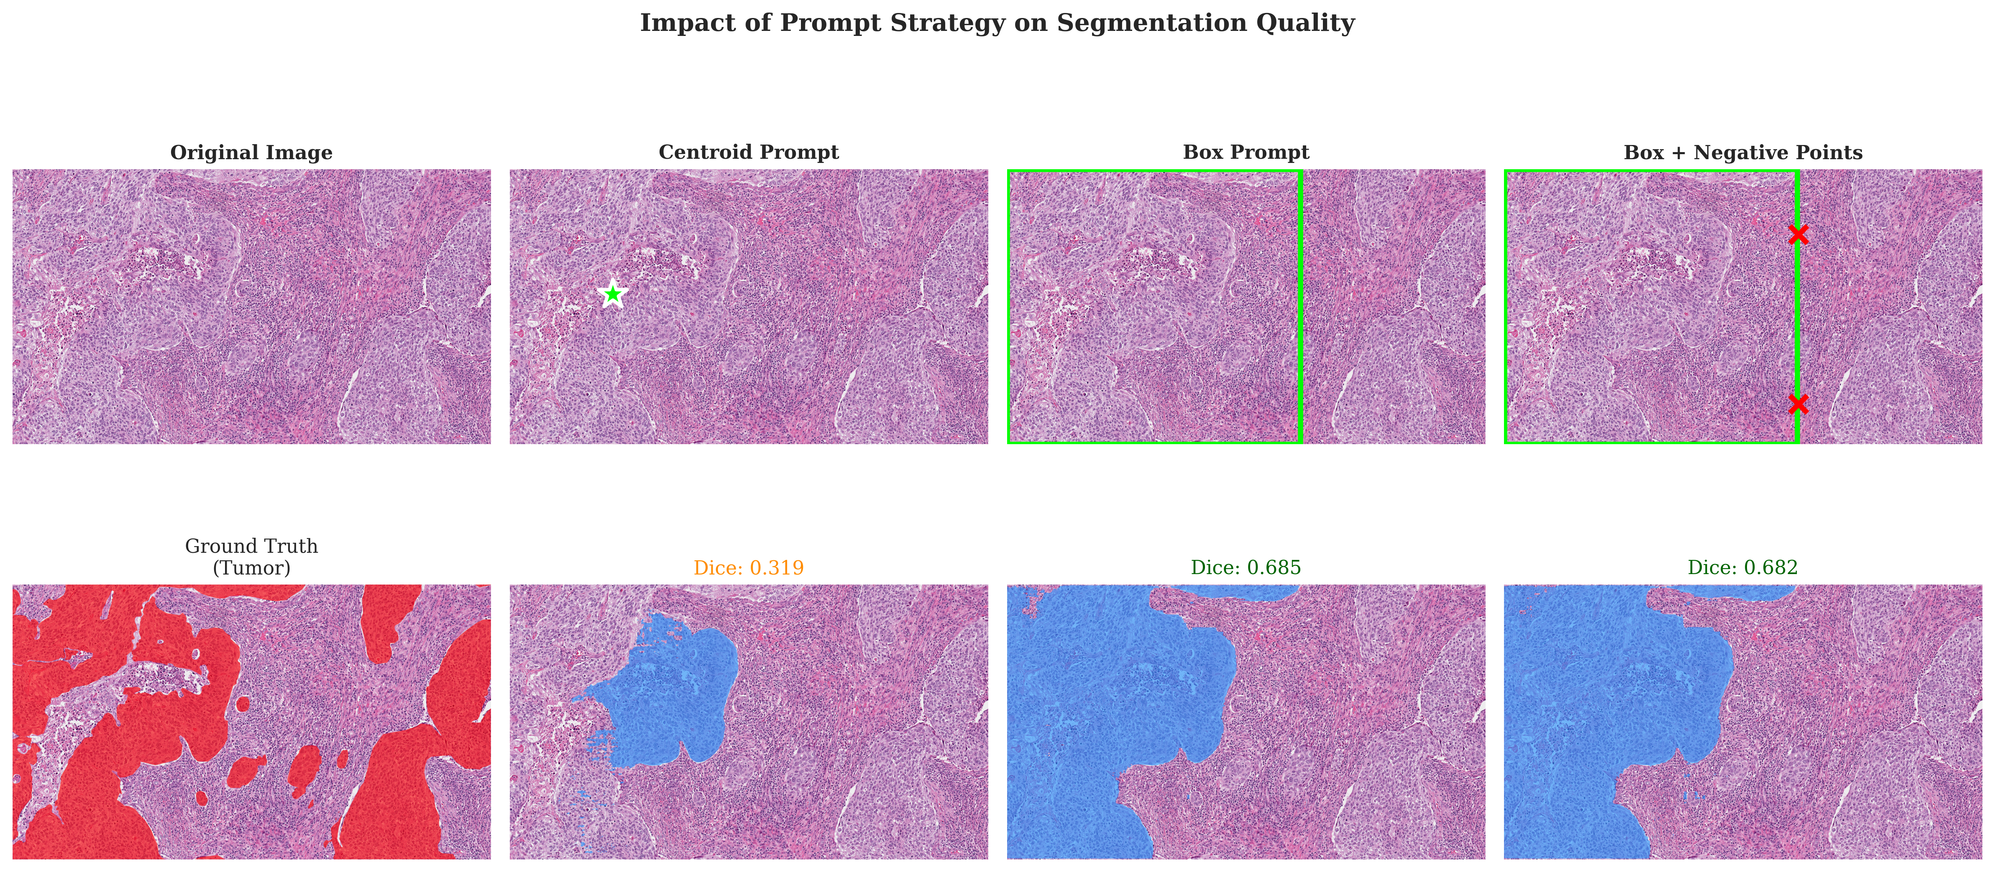
Impact of Prompt Strategy
Same image, different prompts → Box+Neg provides best boundary precision

Slide 7
Segmentation: Prompt Ablation Results
Method | Prompt | Dice | IoU | Δ vs Baseline
SAM2 | Centroid | 0.338 | 0.236 | baseline
SAM2 | Multi-Point | 0.418 | 0.287 | +24%
SAM2 | Box | 0.553 | 0.407 | +64%
SAM2 | Box + Neg Points | 0.555 | 0.408 | +64% ✓
MedSAM | Box | 0.522 | 0.375 | +54%
MedSAM | Box + TTA | 0.536 | 0.389 | +59%

Slide 8
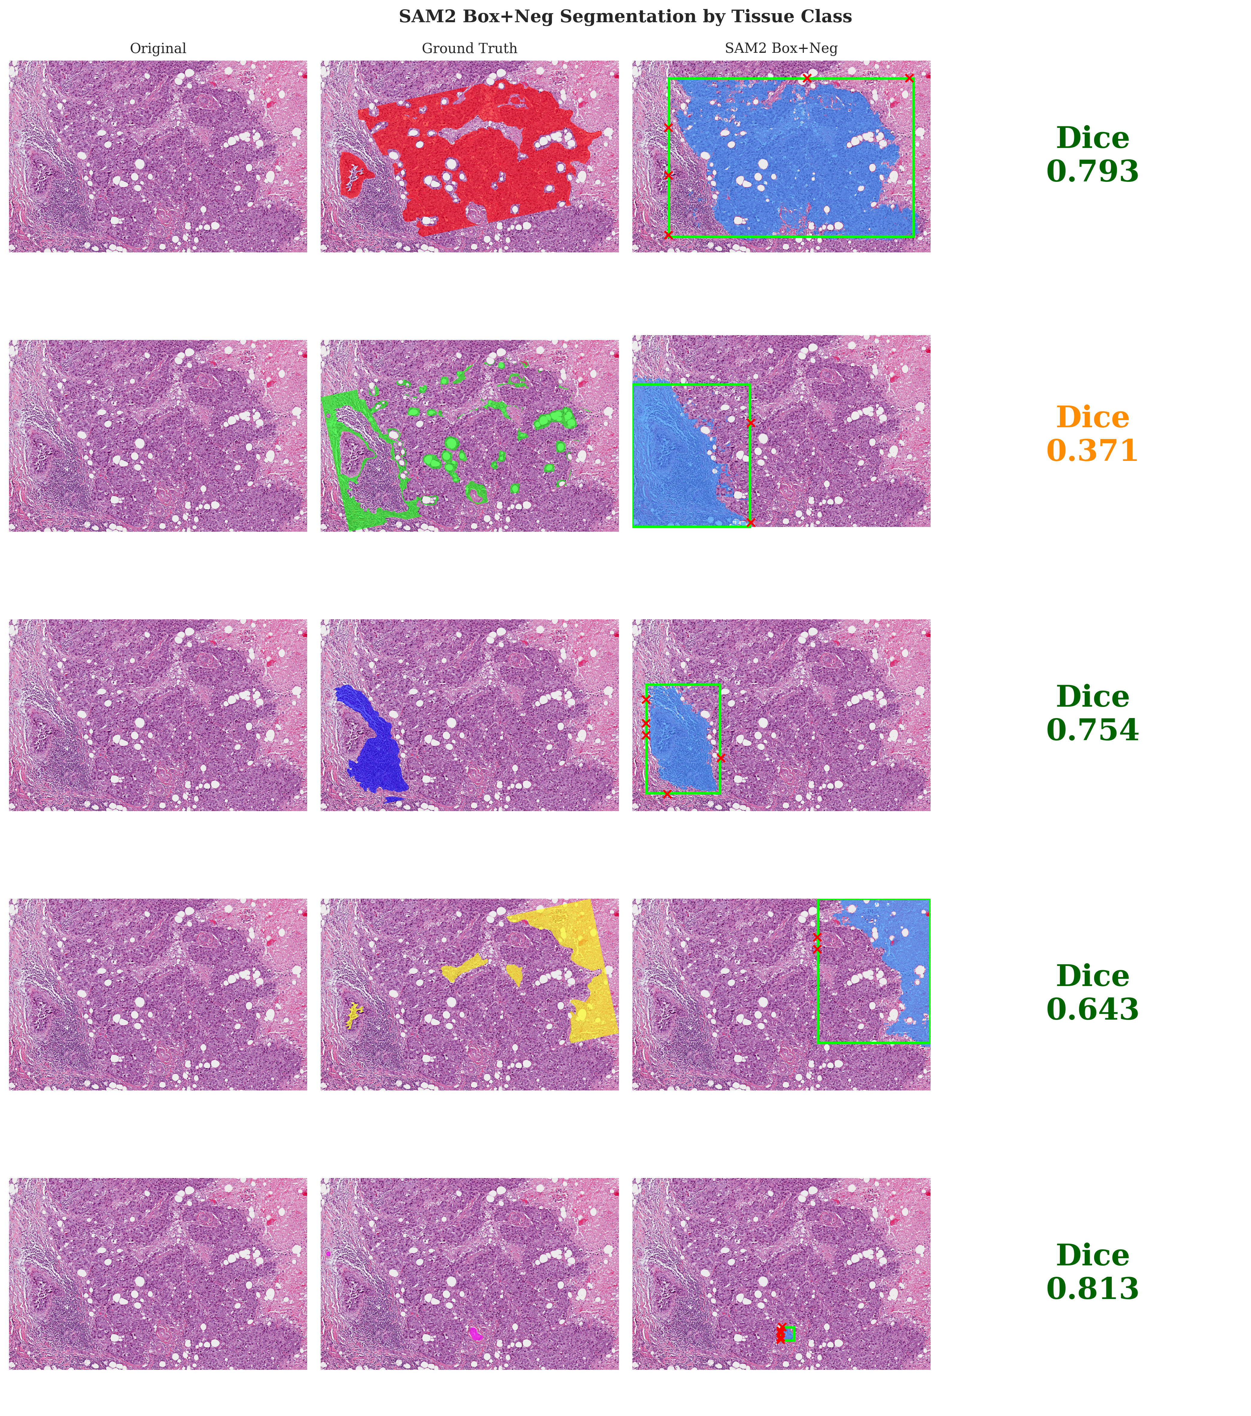
Per-Class Segmentation Performance
Necrosis (0.69) easiest → Blood Vessel (0.50) hardest

Slide 9
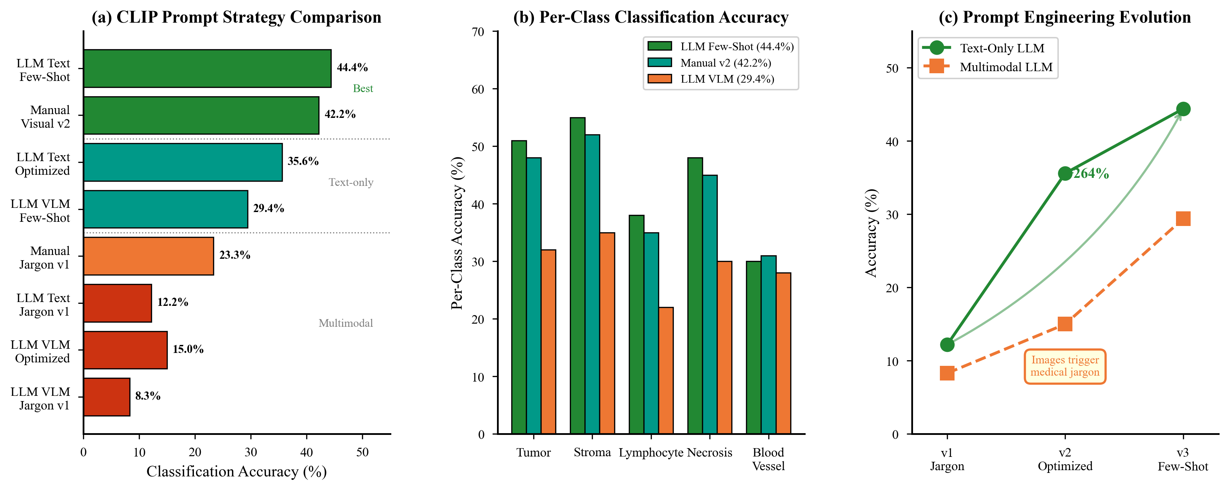
CLIP Classification: Prompt Engineering
LLM Few-shot prompts achieve 44.4% accuracy (+91% over baseline)

Slide 10
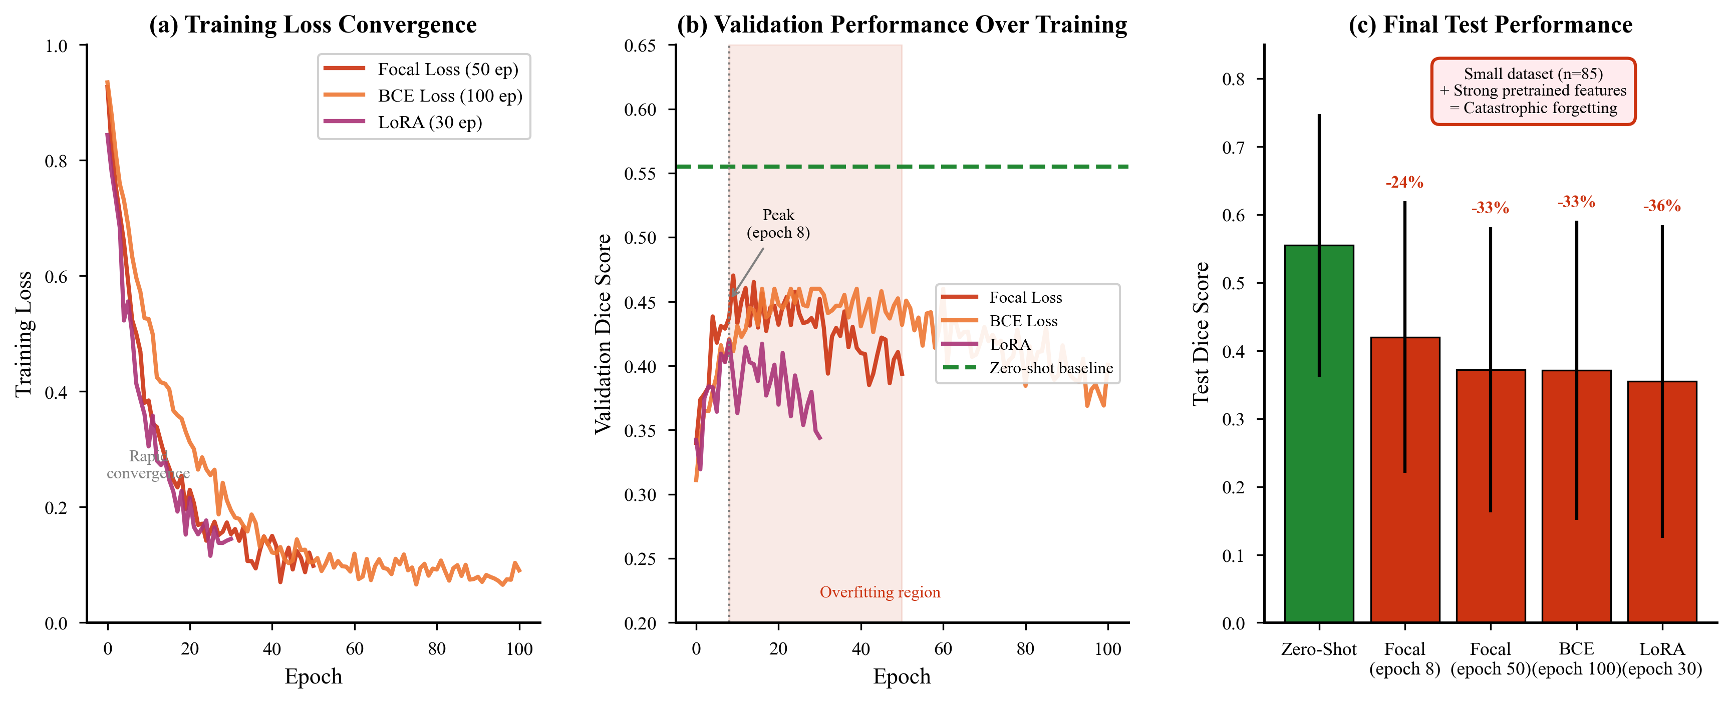
Why Finetuning Failed (-33%)
Small dataset (85 images) → overfitting → catastrophic forgetting

Slide 11
Key Findings
1
Zero-shot > Finetuning
0.555 vs 0.372
33% performance drop with finetuning on small datasets
2
Box prompts > Point prompts
+64%
Spatial context critical for histopathology
3
LLM prompts > Manual prompts
44.4%
Few-shot examples improve CLIP accuracy by 91%
4
Text-only > Multimodal
44% vs 29%
Images trigger medical jargon CLIP doesn't understand

Slide 12
Conclusion & Future Work
• Best Configuration:
• SAM2 + Box + Negative Points (0.555 Dice)
• CLIP + LLM Few-shot Prompts (44.4% Accuracy)
•
• Key Insight: Don't finetune on small medical datasets!
•
• Future Work:
• → Larger datasets (PathVQA, TCGA-full)
• → Domain-specific VFMs (PathSAM, BiomedCLIP)
• → Interactive refinement loop

Slide 13
Thank You!
Questions?
CSCE 689 • Fall 2025 • Texas A&M University

